Slide 1
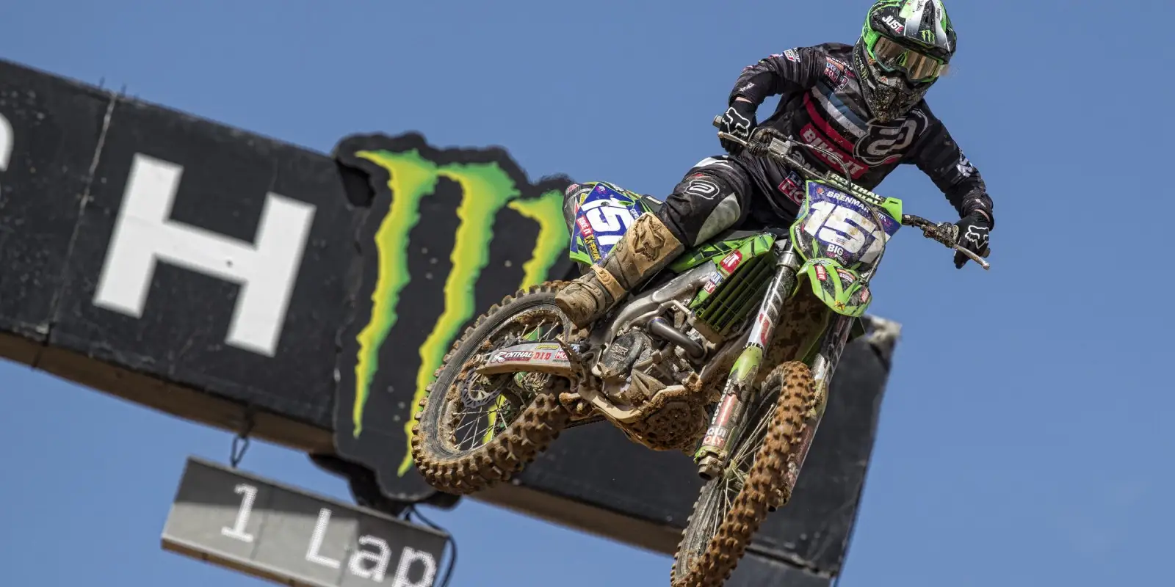

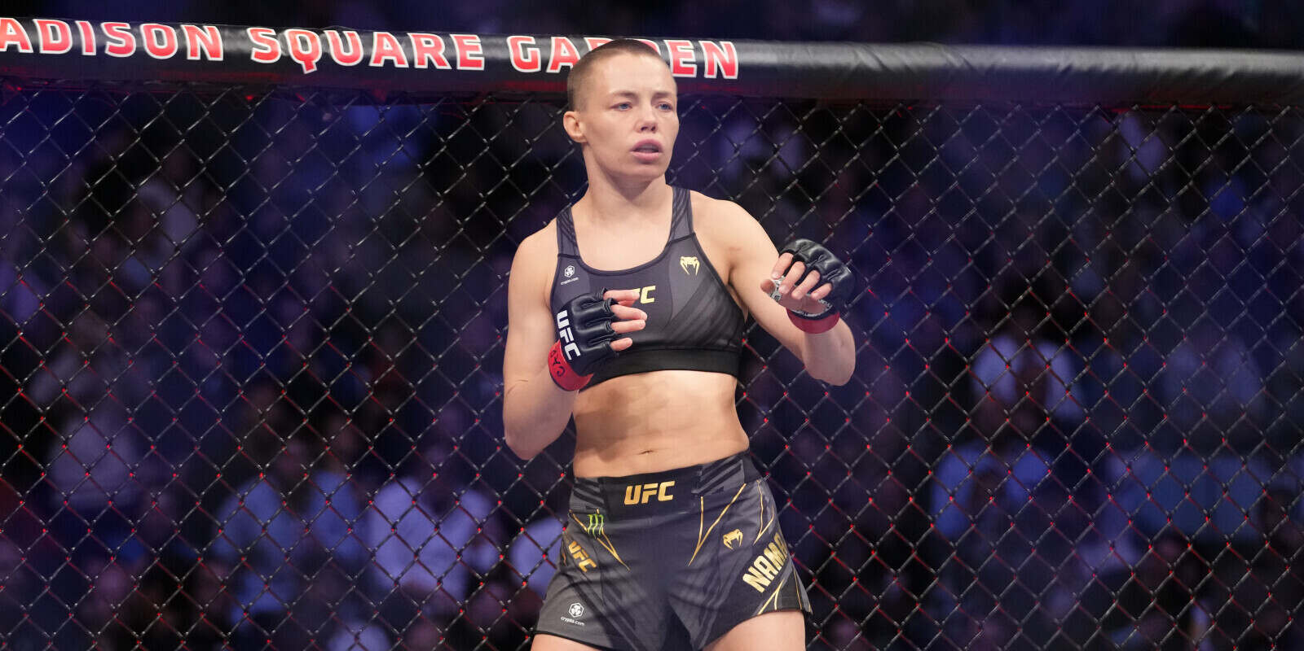
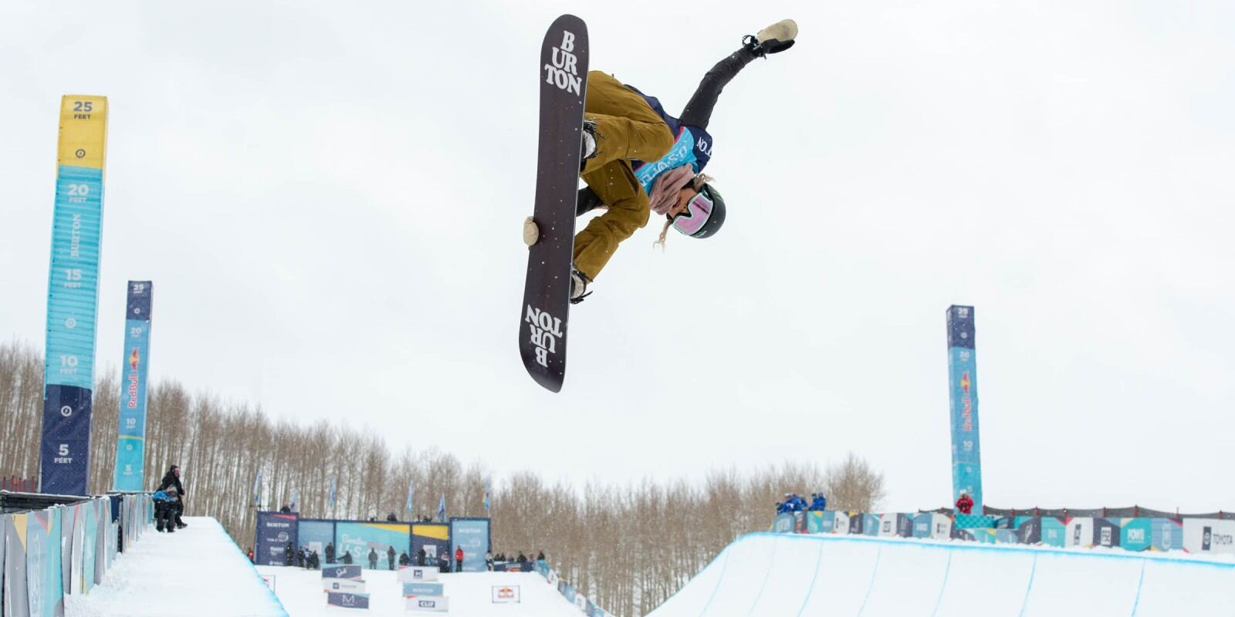
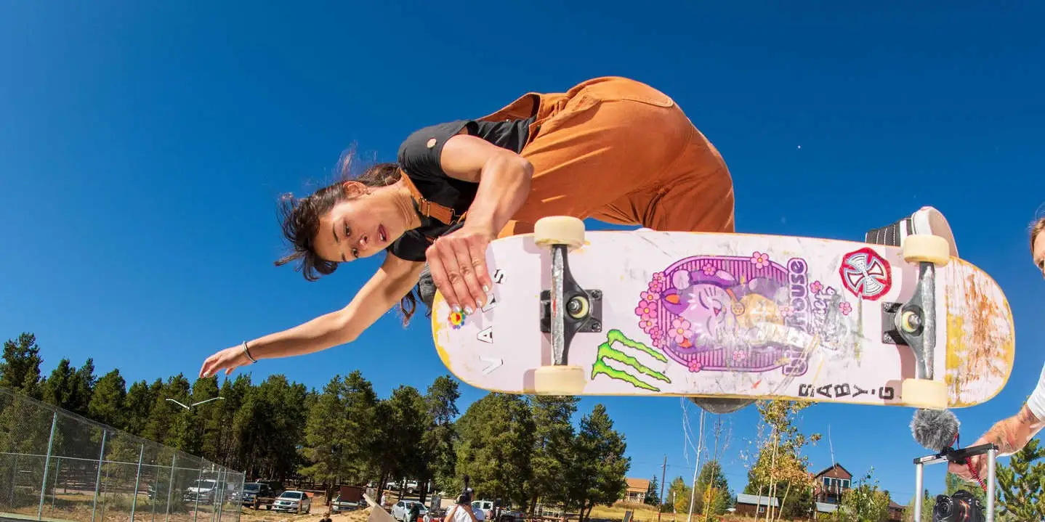
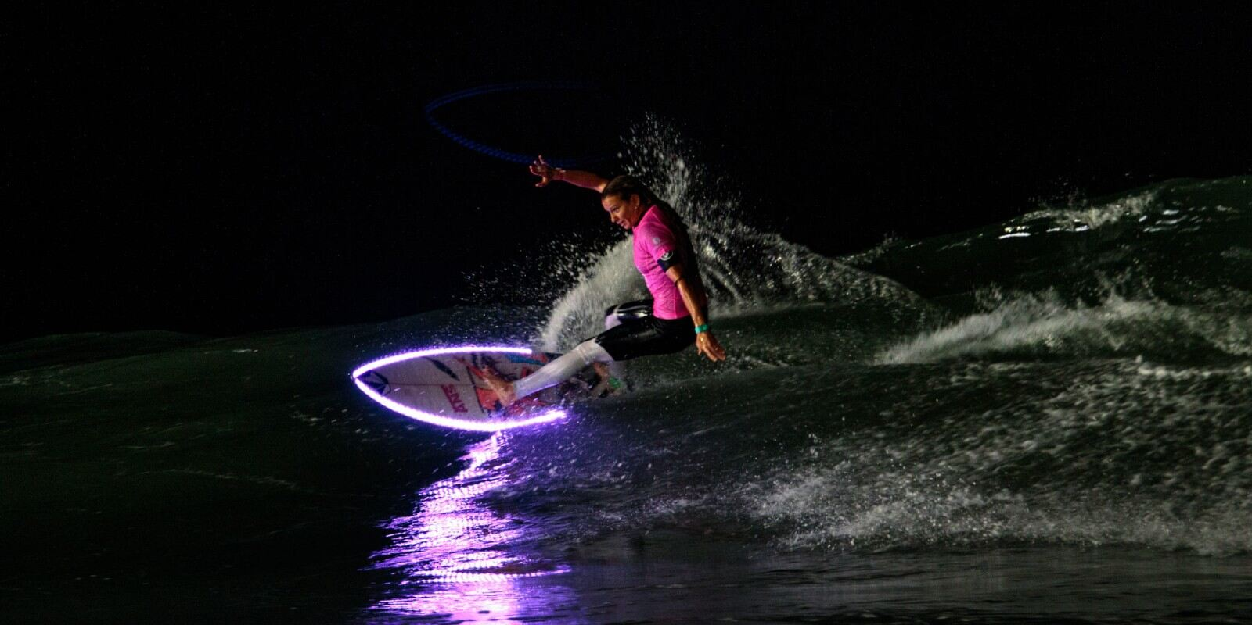
Monster Energy Europe Ltd
Gender Pay Gap 2023

Slide 2

2023 Gender Pay Gap Report for Monster Energy
By improving conversations around inclusion we believe that we can deliver equal reward for like for like work. Through this journey we will continue to monitor and protect the fundamental rights of our staff at Monster Energy
In line with the regulations in the UK, organisations
above 250 employees are publishing specific data
related to their gender pay gap as set out below.
Monster Energy Europe Ltd will continue to publish our Gender Pay Gap reporting.
Monster Energy Europe Ltd. manufactures and distributes energy soft drinks to retail food outlets and convenience stores throughout the United Kingdom and Europe.
Equity is very important at Monster Energy, as a vital cultural driver which together with Equality, Diversity and Inclusion within the workplace are all essential to our success.

Slide 3
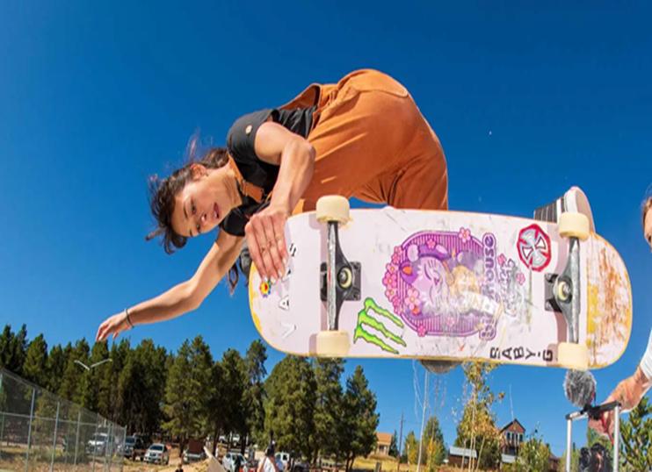



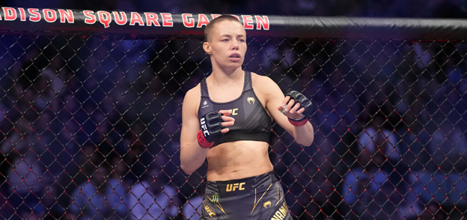
Our report shows the following snapshot of data on 5th April 2022 and reflects the findings for Monster Energy Europe Ltd as it is registered in the UK and required by the legislation
Women’s mean average pay is 27.9% less than the men’s mean average pay.
Women earn 72p for every £1 that men earn, a difference of 28p.
Women’s median average pay is 14.81% less than the men’s median average pay.
Women earn 85p for every £1 that men earn, a difference of 15p.
The national average of median gender pay gap was 14.9% in 2021 (from the Annual Survey of Hours and Earnings figure).

Slide 4


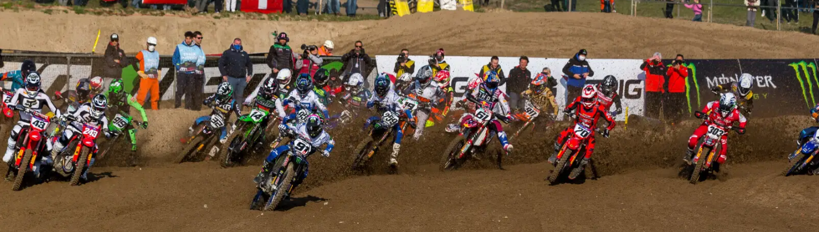
82.76% of men and 84.29% of women received a bonus. The mean bonus gap is 53.32%. The median bonus gap is 25%.
Women earn 72p for every £1 that men earn, a difference of 28p.
The number of men and women who received a bonus was broadly similar. The gap between the median bonus payments is lower from last year. The difference is due to the higher proportion of men in higher paid roles because bonuses are calculated as a percentage of salary.
Also, it’s worth noting, that whilst the European Corporate Headquarters of Monster Energy is based in GB, there are a number of senior women in leadership positions based in other European countries, which are excluded from this data set.

Slide 5
The proportion of Gender by Pay Band
Our analysis of the Gender Pay data shows that the gap within the Upper quartile is largely due to the higher-paid bands being predominantly made up of positions held by men.
The remaining quartiles have smaller differences and shows the lower bands with roles being held by more women.
These differences are also due to many of our upper band roles having been held by employees with longer lengths of service and so there has been less opportunity for promotion.

Slide 6
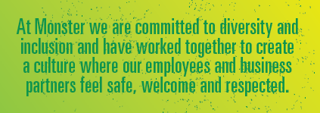
Our Support
DEVELOPMENT :We encourage women to apply for senior positions and take steps to mentor and support those new to leadership roles.
BENEFITS: We offer a range of benefits to our employees to attract both men and women to our roles, such as flexible and hybrid working, family-friendly policies and enhanced holidays
EQUITY: Gender pay gaps are not to be confused with equal pay; we are confident that men and women get paid equally for equivalent jobs across the company. Individuals are rewarded for their contribution and level of responsibility and not because of their gender.
ACTION: We continue to take appropriate action and ensure our policies are fair for all.

Slide 7
Action : Reducing the Gap
Equality, Diversity & Inclusion - Global Leadership Advisory Group
In 2020, we established our Equality, Diversity and Inclusion Global Leadership Advisory Group (EDI Advisory Group), comprised of leaders from across Monster. The EDI Advisory Group was formed to provide insight on our diversity and inclusion efforts and to further integrate EDI principles into our overall strategy and business objectives. The EDI Advisory Group provides guidance to each of the Company’s three regional EDI Councils including one for Europe, Middle East and Africa.
EDI Council Objectives
Establish working councils that fairly represent company diversity of gender, geography, ethnicity, sexual orientation, background, age and experience. Listen and learn from their opinions and proposals on equality, diversity and inclusion to create working groups, initiatives and programs to act and deliver the global EDI mission and vision.
Create an environment delivering employee engagement and an ongoing dialogue with all employees where people are able to offer feedback, comment and make proposals on the historical, current and future issues and topics of EDI.
Initiate review and ongoing assessment of all current policies and processes with regard to attracting, hiring, and retaining talent to ensure they support and deliver against the Monster equal opportunity, diversity and inclusion mission as well as removing any barriers to its success.
Devise and set up a continuous program of education and learning opportunities for everyone to develop and deepen individual and personal understanding of equality, diversity and inclusion.
Train, mentor and provide capability enhancement programs for all specifically including attitudes and behavioural considerations and development.
Participate in external community led efforts to improve quality of life and opportunities, providing financial support for underprivileged youth education and ongoing philanthropic efforts to advance the idea of inclusion in everything we do

